Slide 1
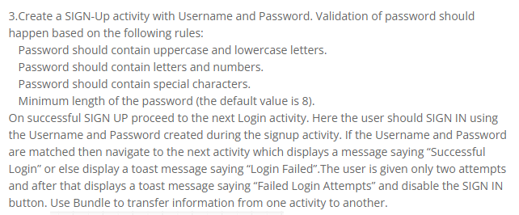
Program3

Slide 2
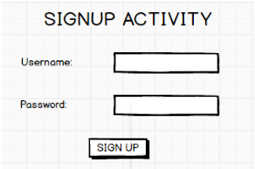
Analysis:
Text view(signup activity,user name,password)
Edit text(2)
Button(signup)

Slide 3
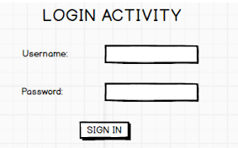
Analysis:
Text view(login activity,user name.password)
Edit text(2)
Button(signin)
For creating new activity for login:right click on apps->go to new->select activity->empty activity.

Slide 4
Java code:signup
public class MainActivity extends AppCompatActivity implements View.OnClickListener { EditText Signup_Username, Signup_Password; Button btnSignup; String regularExpression = "^(?=.*[A-Z])(?=.*[a-z])(?=.*\\d)(?=.*[@$!])[A-Za-z\\d@$!]{8,}$"; @Override protected void onCreate(Bundle savedInstanceState) { super.onCreate(savedInstanceState); setContentView(R.layout.activity_main); Signup_Username=(EditText)findViewById(R.id.Signup_username); Signup_Password = (EditText)findViewById(R.id.Signup_password); btnSignup = (Button)findViewById(R.id.btn_signin); btnSignup.setOnClickListener(this); }

Slide 5
@Override public void onClick(View view) { String username = Signup_Username.getText().toString(); String password = Signup_Password.getText().toString(); if (validatePassword(password)) {
Toast.makeText(getBaseContext(),"Validpassword",Toast.LENGTH_LONG).show(); Bundle bundle = new Bundle(); bundle.putString("user", username); bundle.putString("pwd", password); Intent it = new Intent(this, Login.class); it.putExtra("data", bundle); startActivity(it); }
else
{
Toast.makeText(getBaseContext(), "Invalid password", Toast.LENGTH_LONG).show(); } } private boolean validatePassword(String password) { Pattern pattern = Pattern.compile(regularExpression); Matcher matcher = pattern.matcher(password); return matcher.matches(); } }

Slide 6
Java code:login
public class Login extends AppCompatActivity implements View.OnClickListener { EditText LoginUsername,LoginPassword; Button btnLogin; String user,pass; int count=0;
@Override protected void onCreate(Bundle savedInstanceState) { super.onCreate(savedInstanceState); setContentView(R.layout.activity_login); LoginUsername=(EditText)findViewById(R.id.Signup_username); LoginPassword=(EditText)findViewById(R.id.Signup_password); btnLogin=(Button)findViewById(R.id.btn_signin); btnLogin.setOnClickListener(this); Bundle bundle=getIntent().getBundleExtra("data"); user=bundle.getString("user"); pass=bundle.getString("pwd"); }

Slide 7
@Override public void onClick(View view) { String user1=LoginUsername.getText().toString(); String pass1=LoginPassword.getText().toString(); if(user.equals(user1)&&pass.equals(pass1)) { Toast.makeText(this,"login Successful",Toast.LENGTH_LONG).show(); } else { count++; if(count==3) { btnLogin.setEnabled(false); Toast.makeText(this,"Failed login Attempts",Toast.LENGTH_LONG).show(); } else { Toast.makeText(this,"Login Failed"+count,Toast.LENGTH_LONG).show(); } } } }

Slide 8
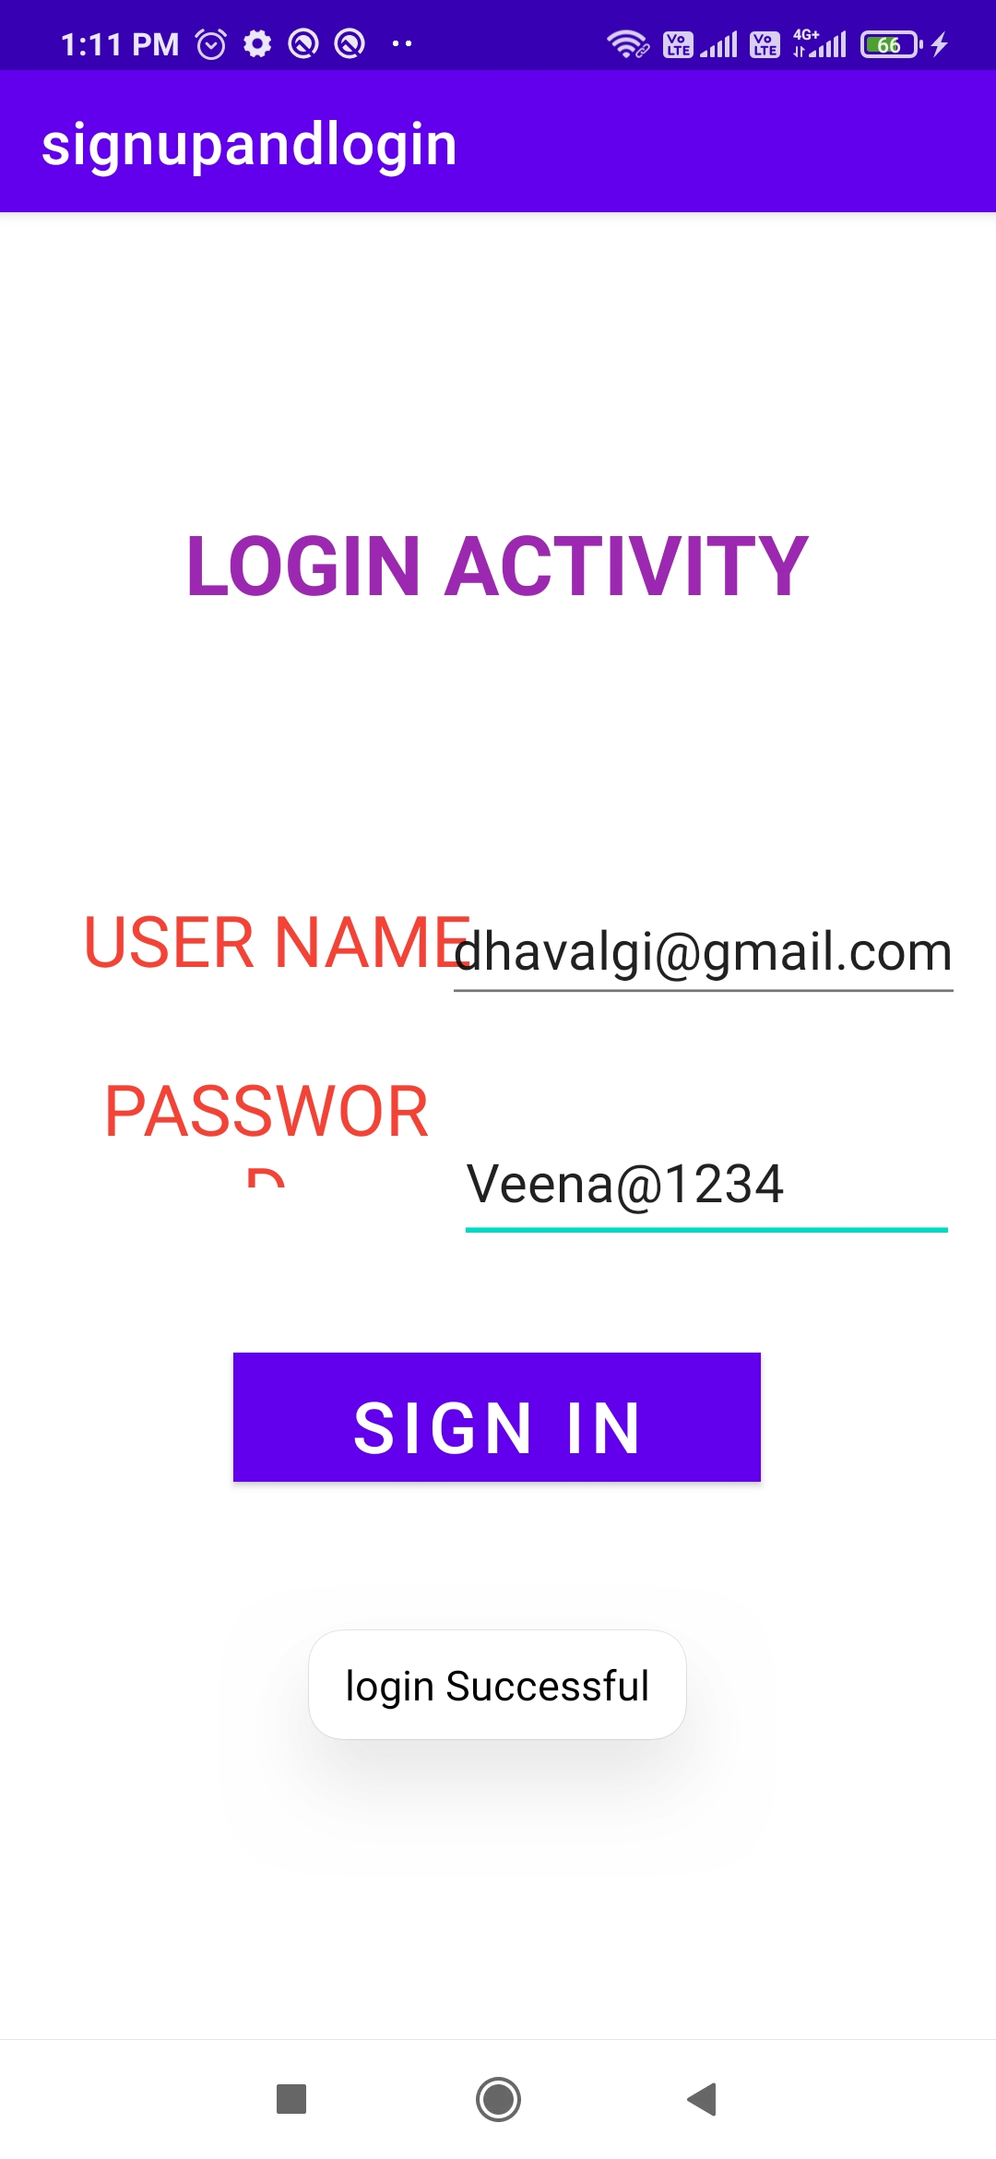
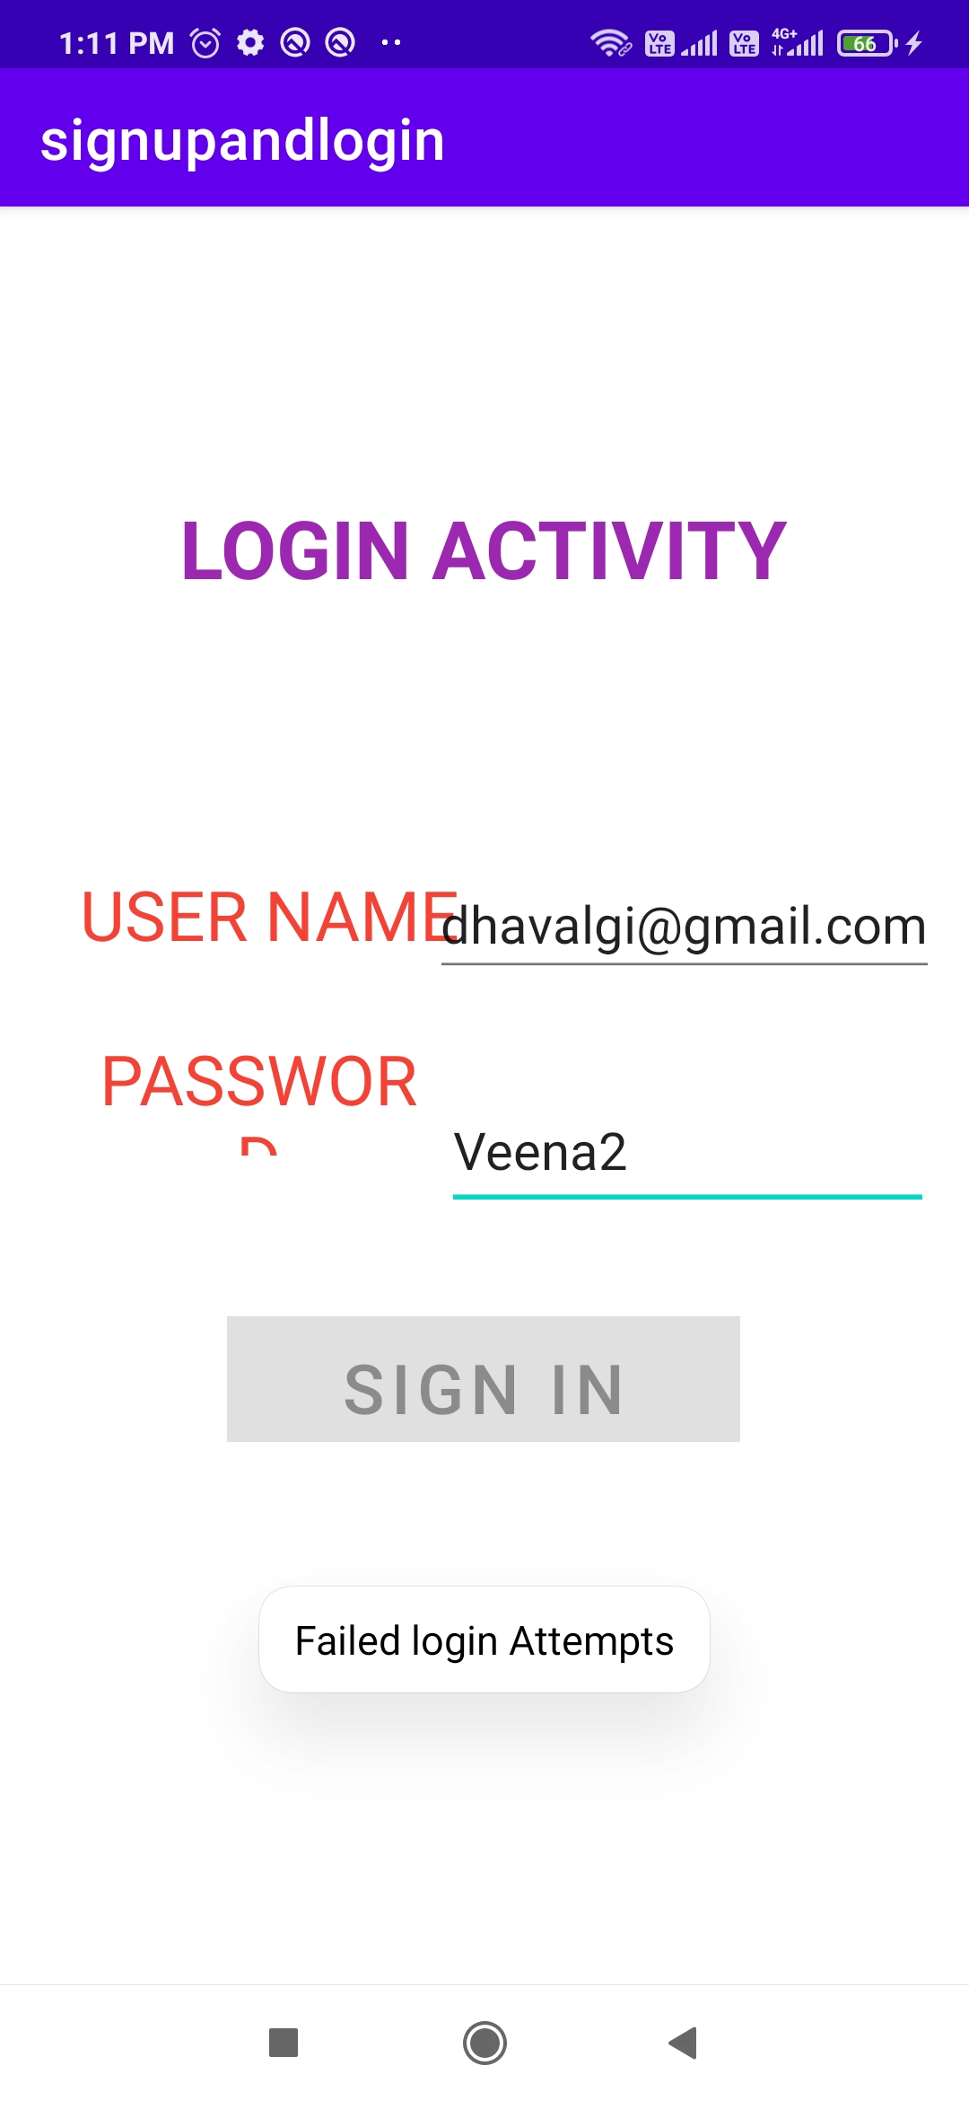

Slide 9
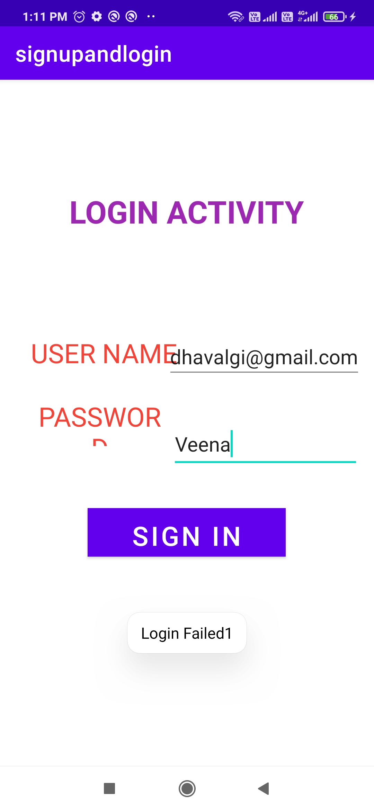
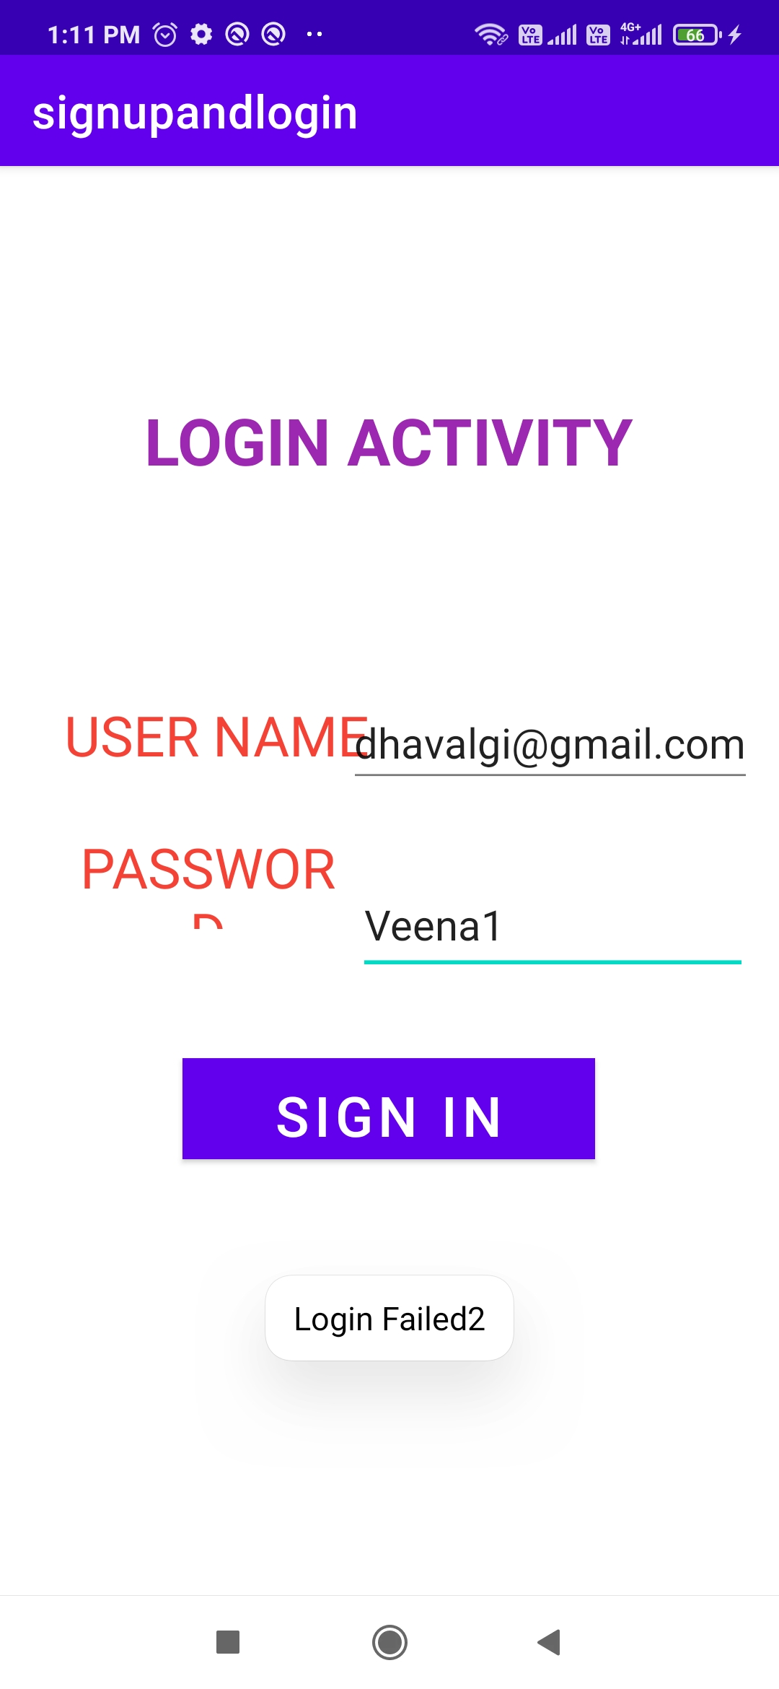

Slide 10
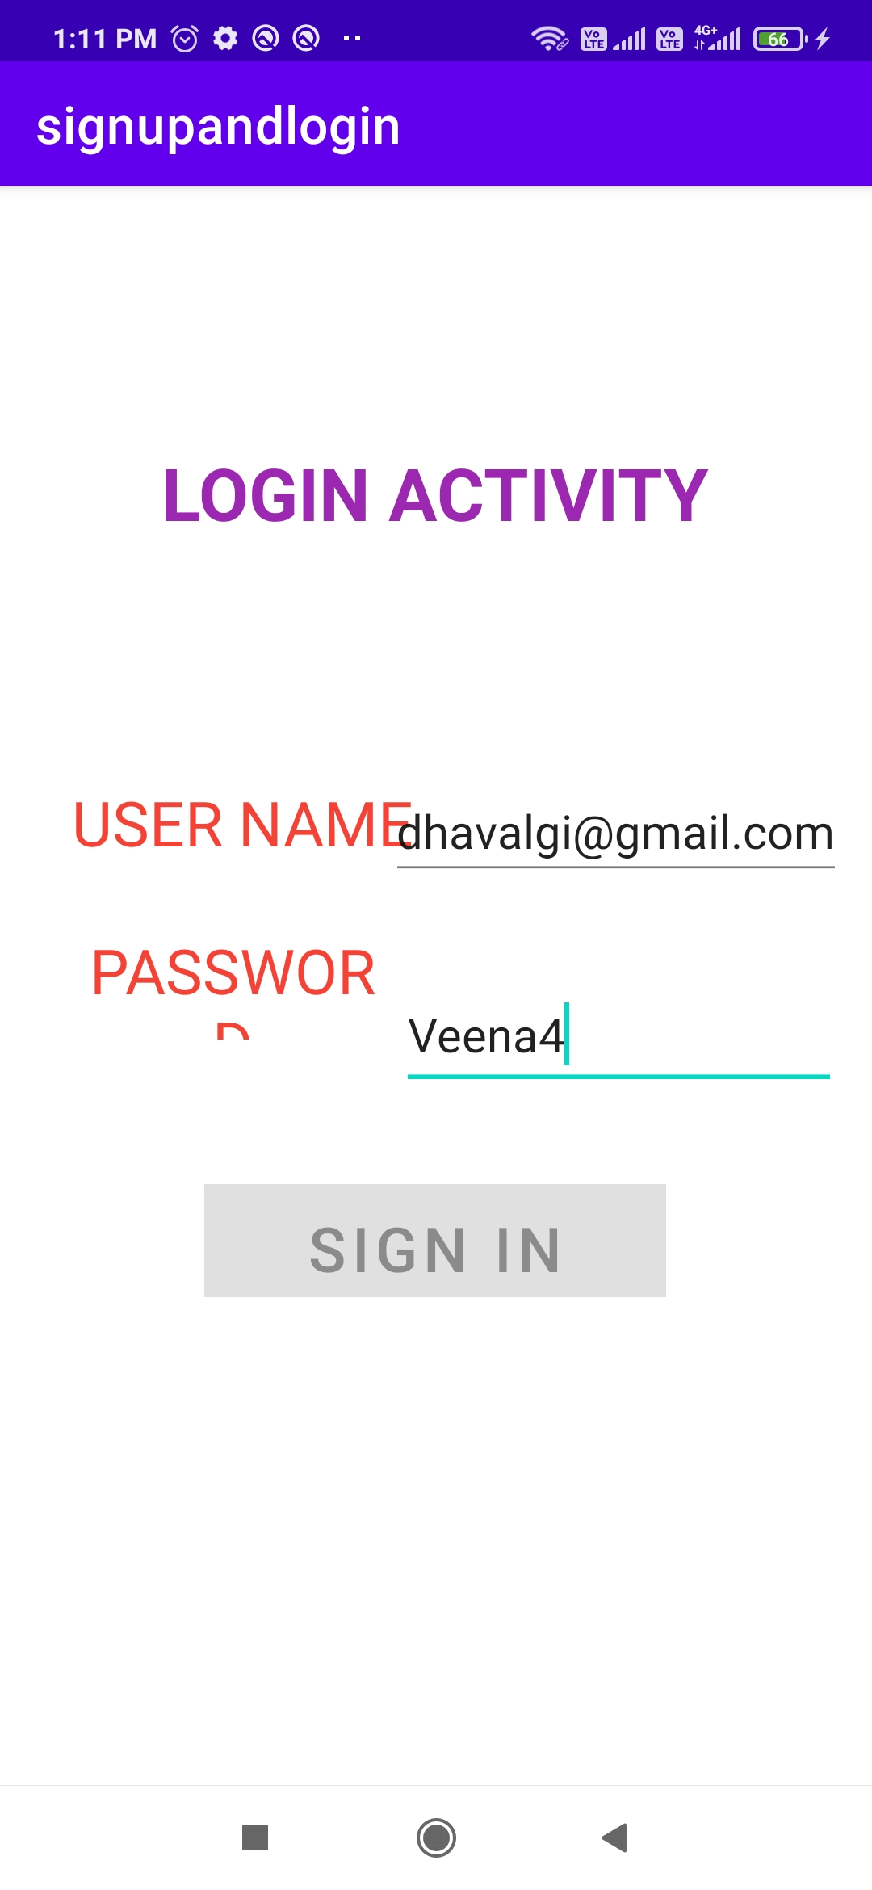
Signin disabled

Slide 11
Thank you

